Slide 1
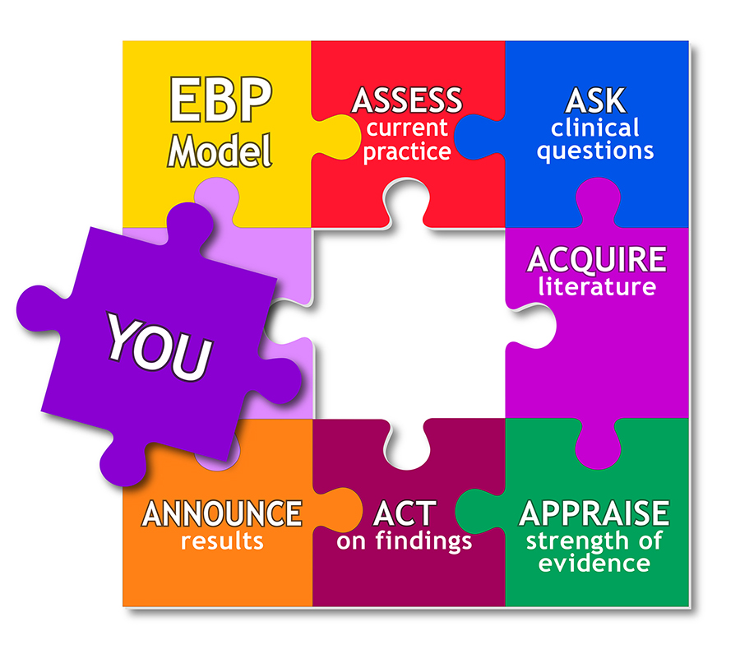
Evidence Based Approaches
Week 10-Slide
Evidence based Approaches

Slide 2

Aim;
To Conduct a review of key literature relating to a research topic towards improvements in care practice.
Learning Outcomes;
Organizing the literature review structure
Evaluate the reliability and validity of own literature review
Explore the concept of skimming and scanning technique

Slide 3


Slide 4

Getting Started
Once you are clear on what specific areas/issues your literature review will cover, you should start by searching for relevant reading material.
You should aim to use a variety of different types of sources, which can include, but is not limited to:

Slide 5

Homework Reading techniques
In pairs, explain
Why are these important when carrying out a literature review?
Scanning
Skimming

Slide 6

SKIMMING & SCANNING
Skimming and scanning are reading techniques that use rapid eye movement and keywords to move quickly through text for slightly different purposes.
Skimming is reading rapidly in order to get a general overview of the material.
Scanning is reading rapidly in order to find specific facts.
While skimming tells you what general information is within a section, scanning helps you locate a particular fact.
Skimming is like snorkeling, and scanning is more like pearl diving

Slide 7

Skimming
Skimming often refers to the way in which one reads at a faster rate to gain the general idea about the text without paying heed to the intentional and detailed meaning of the text.
For Example - When one reads the text only in order to understand the thesis statement, in one or two lines.
Skimming is achieved by reading that text only which is considered to be relevant.
Skimming requires a lower understanding of word recognition than compared to scanning.
Procedure - Read the introductory paragraph and the conclusion paragraph very carefully. You should search for headings and subheadings to get a good grasp of the idea.

Slide 8

Use skimming in previewing (reading before you read), reviewing (reading after you read), determining the main idea from a long selection you don't wish to read, or when trying to find source material for a research paper.
Skimming to save time
To skim, prepare yourself to move rapidly through the pages. You will not read every word; you will pay special attention to typographical cues-headings, boldface and italic type, indenting, bulleted and numbered lists.
You will be alert for key words and phrases, the names of people and places, dates, nouns, and unfamiliar words.

Slide 9

In general follow these steps:
Read the table of contents or chapter overview to learn the main divisions of ideas.
Glance through the main headings in each chapter just to see a word or two.
Read the headings of charts and tables.
Read the entire introductory paragraph and then the first and last sentence only of each following paragraph.
For each paragraph, read only the first few words of each sentence or to locate the main idea.

Slide 10
Stop and quickly read the sentences containing keywords indicated in boldface or italics.
When you think you have found something significant, stop to read the entire sentence to make sure.
Then go on the same way.
Resist the temptation to stop to read details you don't need.
Read chapter summaries when provided.

Slide 11
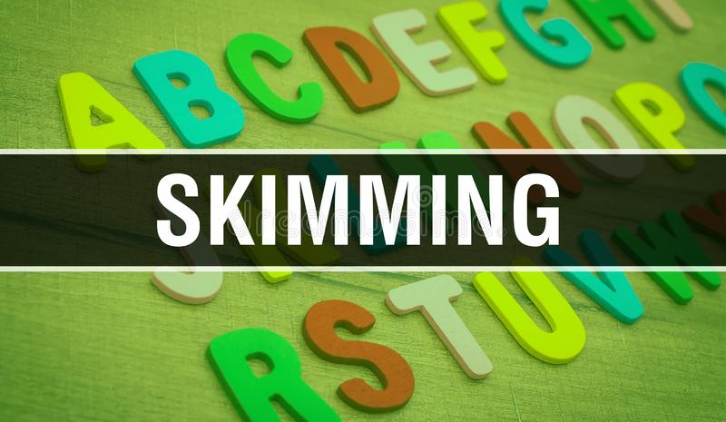
Good skimmers do not skim everything at the same rate or give equal attention to everything.
While skimming is always faster than your normal reading speed, you should slow down in the following situations:
DON’T’S OF SKIMMING
When you skim introductory and concluding paragraphs
When you skim topic sentences
When you find an unfamiliar word
When the material is very complicated

Slide 12

Scanning
Scanning refers to the technique when one looks into the document or the text provided for searching some specific text such as some keywords.
Example - Now it may be applied to the real-life example of a dictionary, wherein one looks for a specific word meaning or a directory wherein one searches for the phone number of someone.
Scanning requires one to have a look at the whole document quickly at least once.

Slide 13
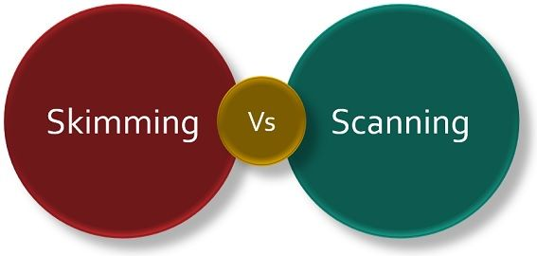
Scanning requires a higher understanding of word recognition compared to skimming.
Procedure - You should search for headings and subheadings to get a good grasp of the idea, as to where your required detail will be found.
Skimming and scanning, therefore, are two very different strategies for speed reading.
They are used for different purposes, and they require different reading skills, but they are very significant to go about reading comprehension.

Slide 14
Scanning for research and study
Scanning, too, uses keywords and organizational cues. But while the goal of skimming is a bird's-eye view of the material, the goal of scanning is to locate and swoop down on particular facts.
Skim this material first to decide if it is likely to contain the facts you need. Don't forget to scan tables of contents, summaries, indexes, headings, and typographical cues.
To make sense of lists and tables, skim them first to understand how they are organized:
alphabetical,
chronological, or most-to-least, for example.
If after skimming you decide the material will be useful, go ahead and scan:

Slide 15
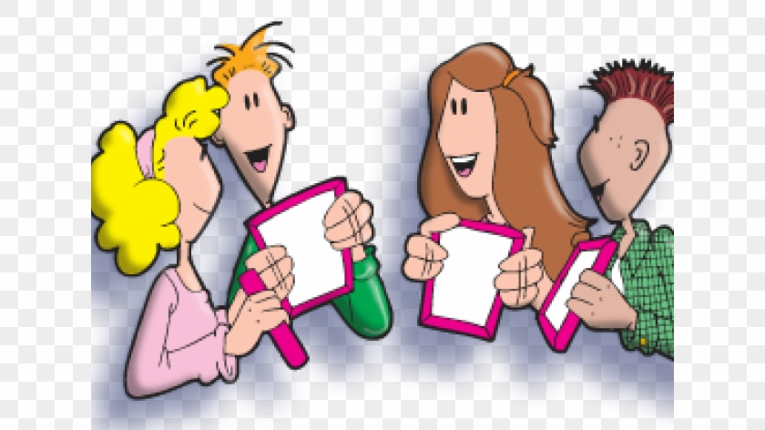
LO1 Activity
https://youtu.be/F1wPYHa5nUg
With extracts from the video link,
Identify the difference between skimming and scanning as a reading technique for your literature review and research project.
Feedback to the class

Slide 16

Know
Know what you're looking for. Decide on a few key words or phrases–search terms, if you will. You will be a flesh-and-blood search engine.
Look
Look for only one keyword at a time. If you use multiple keywords, do multiple scans.
Let
Let your eyes float rapidly down the page until you find the word or phrase you want.
Read
When your eye catches one of your keywords, read the surrounding material carefully.

Slide 17


10 minutes break

Slide 18

Organising your literature review Introduction/ background

Slide 19
Ways to Organize Your Literature Review introduction
Chronologically
By author
Different theoretical approaches
Specific concepts or issues
Different methodologies
Level of support to your hypothesis/theory/topic of review

Slide 20

Individually / small group activity (10 minutes)
Working in small group, with extracts from the video clip,
Identify and Explain the Ways to Organize Your Literature Review
Group present feedback.
All you do is:
Gather the summaries of your sources.
Put the summaries in groups based on theme.
Turn each group into a paragraph with a topic sentence and transitions between each source.
Add introduction and conclusion paragraphs.
You're done! Here is a simple demonstration of the procedure:
https://youtu.be/UoYpyY9n9YQ
http://www.peakwriting.com/litreview/...

Slide 21
Structure of LO3-(Literature Review)
Introduction/ background
Main
Conclusion

Slide 22
Research the meaning of reliability and validity
Explain the difference between reliability and validity
https://youtu.be/fnF2hrLZHoA
https://youtu.be/9ltvDNAsO-I

Slide 23
Focusing on reliability and validity
Reliability and Validity activity
Reliability and validity are concepts used to evaluate the quality of research. They indicate how well a method, technique or test measures something.
Reliability is about the consistency of a measure, and validity is about the accuracy of a measure.
For research and testing, there are subtle differences. Reliability implies consistency: if you take the ACT five times, you should get roughly the same results every time. A test is valid if it measures what it's supposed to. Tests that are valid are also reliable (Scribbr, 2019).

Slide 24
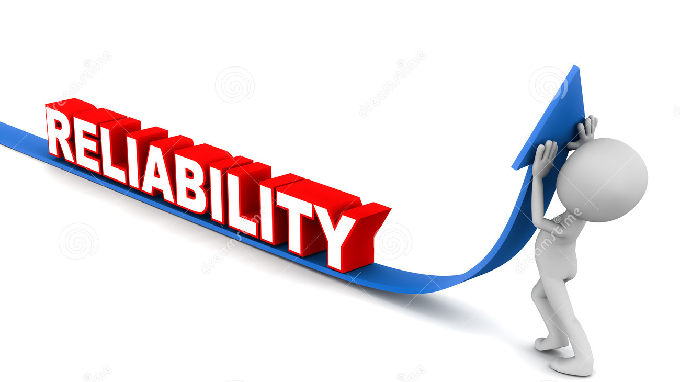
What is reliability?
Reliability refers to how consistently a method measures something.
If the same result can be consistently achieved by using the same methods under the same circumstances, the measurement is considered reliable.
Reliability and validity are closely related, but they mean different things.
A measurement can be reliable without being valid. However, if a measurement is valid, it is usually also reliable.
EXAMPLE:
You measure the temperature of a liquid sample several times under identical conditions.
The thermometer displays the same temperature every time, so the results are reliable.
A doctor uses a symptom questionnaire to diagnose a patient with a long-term medical condition.
Several different doctors use the same questionnaire with the same patient but give different diagnoses.
This indicates that the questionnaire has low reliability as a measure of the condition (Scribbr, 2019).

Slide 25
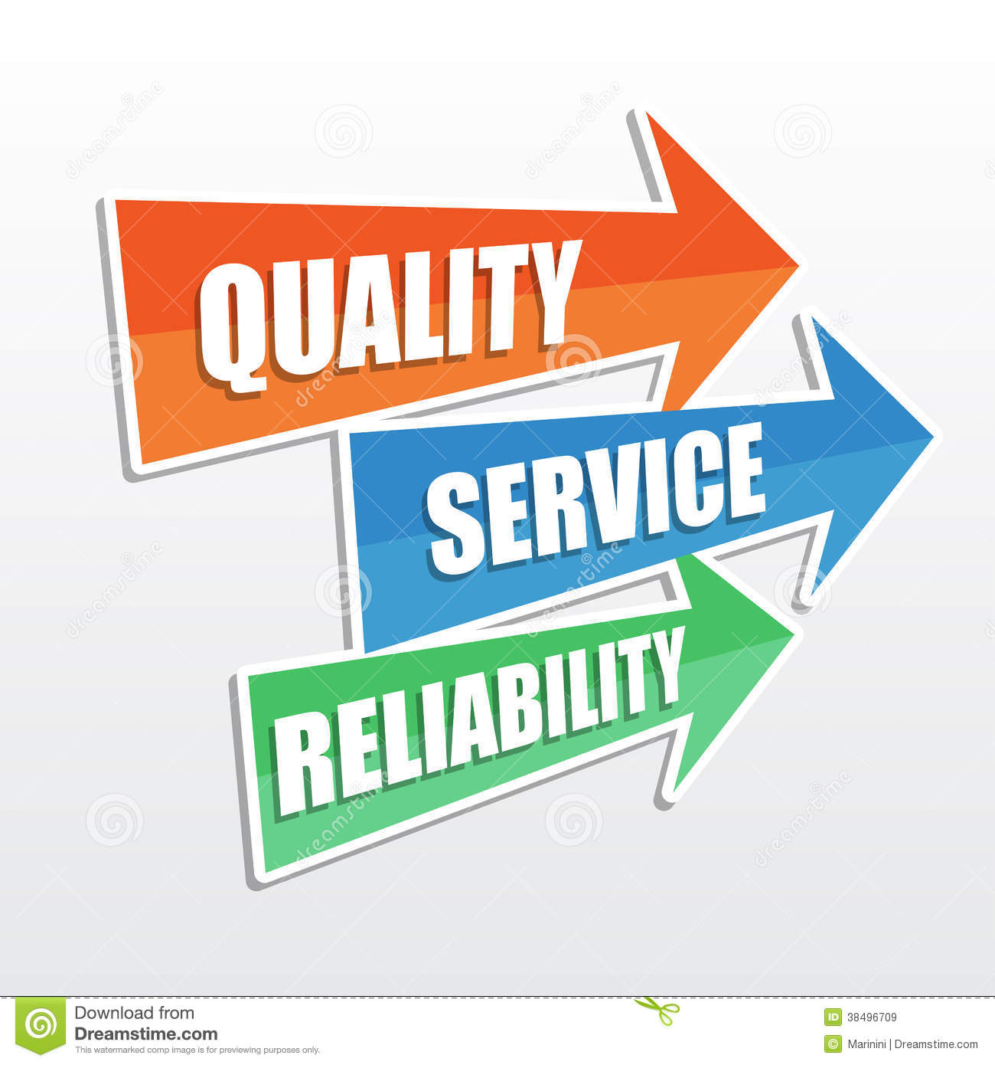
Research reliability
In simple terms, research reliability is the degree to which research method produces stable and consistent results. A specific measure is considered to be reliable if its application on the same object of measurement number of times produces the same results (Golafshani, 2003).

Slide 26

What is validity
In general, VALIDITY is an indication of how sound your research is. More specifically, validity applies to both the design and the methods of your research.
Validity in data collection means that your findings truly represent the phenomenon you are claiming to measure. (Golafshani, 2003).

Slide 27
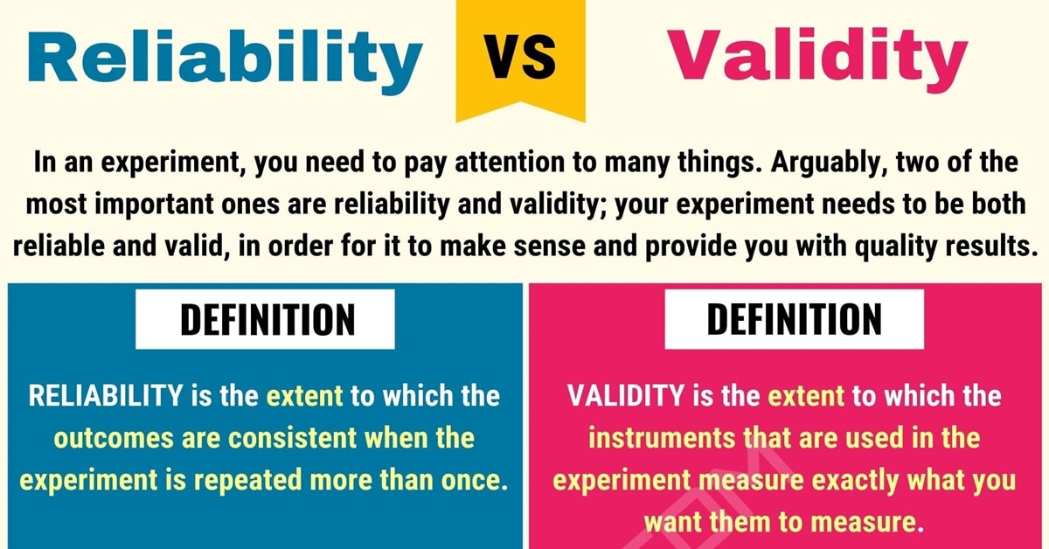

Slide 28
Validity and Reliability
In research terms, reliability refers to consistency. Just as you can count on the consistency of your friend, when something is reliable in science this indicates some level of consistency.
In science, validity refers to accuracy; if something is not accurate, it is not valid (Golafshani, 2003).

Slide 29
Glossary of different health care Perspectives
BMA: British Medical Association
BMJ-British Medical Journal
CCG: Clinical Commissioning Groups
DCN: District Councils Network
DPH: Director of Public Health
GP: General Practitioner
HWB(s): Health and Wellbeing Board(s)
JSNA: Joint Strategic Needs Assessment
JHWS: Joint Health and Wellbeing Strategy
RCN: Royal College of Nursing
LSHTM: London School of Hygiene and Tropical Medicine
NHSE: NHS England
PCT: Primary Care Trust
PHE: Public Health England
PHOF: Public Health Outcomes Framework
PRUComm: Policy Research Unit in Commissioning and the Health Care System
UKFPH: UK Faculty of Public Health

Slide 30
WRAP-UP
Question and Answer Session

Slide 31
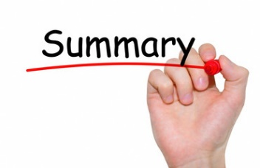
Today, we have learnt…..
In this session:
All / most learners were able to:
Explore the structure of a literature review
Evaluate the reliability and validity of own literature review
Explain the Boolean methods can be used to narrow search

Slide 32

End
This session has ended. Thank for your attendance and active participation. IT’S ALL ABOUT YOU !

Slide 33
Bibliography
The Royal Literary Fund. (2019). The structure of a literature review. [online] Available at: https://www.rlf.org.uk/resources/the-structure-of-a-literature-review/ [Accessed 19 Nov. 2019].
Uscupstate.libguides.com. (2019). LibGuides: Literature Review: Purpose of a Literature Review. [online] Available at: https://uscupstate.libguides.com/c.php?g=627058&p=4389968 [Accessed 19 Nov. 2019].
Scribbr. (2019). Reliability vs Validity in Research | Differences, Types and Examples. [online] Available at: https://www.scribbr.com/methodology/reliability-vs-validity/ [Accessed 19 Nov. 2019].
Golafshani, N., 2003. Understanding reliability and validity in qualitative research. The qualitative report, 8(4), pp.597-606.
Cronin, P., Ryan, F. and Coughlan, M., 2008. Undertaking a literature review: a step-by-step approach. British journal of nursing, 17(1), pp.38-43.
Golafshani, N., 2003. Understanding reliability and validity in qualitative research. The qualitative report, 8(4), pp.597-606.
McCusker, K. and Gunaydin, S., 2015. Research using qualitative, quantitative or mixed methods and choice based on the research. Perfusion, 30(7), pp.537-542.
Scribbr. (2019). Reliability vs Validity in Research | Differences, Types and Examples. [online] Available at: https://www.scribbr.com/methodology/reliability-vs-validity/ [Accessed 19 Nov. 2019].

Slide 34
Bibliography
Williamson, G.R., Bellman, L. and Webster, J., 2011. Action research in nursing and healthcare. Sage.
Meyer, J., 2000. Using qualitative methods in health related action research. Bmj, 320(7228), pp.178-181.
Libguides.ithaca.edu. (2019). LibGuides: Research 101: Primary and Secondary Sources. [online] Available at: https://libguides.ithaca.edu/research101/primary [Accessed 12 Nov. 2019].
Hox, J.J. and Boeije, H.R., 2005. Data collection, primary versus secondary.
Bryman, A., 2006. Integrating quantitative and qualitative research: how is it done?. Qualitative research, 6(1), pp.97-113.
McCusker, K. and Gunaydin, S., 2015. Research using qualitative, quantitative or mixed methods and choice based on the research. Perfusion, 30(7), pp.537-542.
Lieber, E., 2009. Mixing qualitative and quantitative methods: Insights into design and analysis issues. Journal of Ethnographic & Qualitative Research, 3(4).

